Slide 1
Hashing

Slide 2
If you need to find a value in a list what is the most efficient way to
perform the search?
• Linear search
• Binary search
• Can we have O(1)?

Slide 3
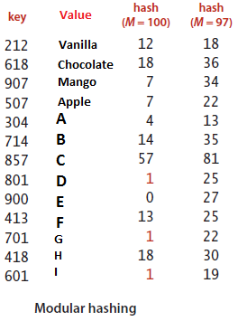
Given an array A, if i is the key, then we can find the value by simply looking up A[i].
Hash functions transform keys
into array indices.
Index | Value
0 | E
1 | D
2
3
4 | A
5
6
7 | Mango, Apple
8
9
10
11
12 | Vanilla

Slide 4
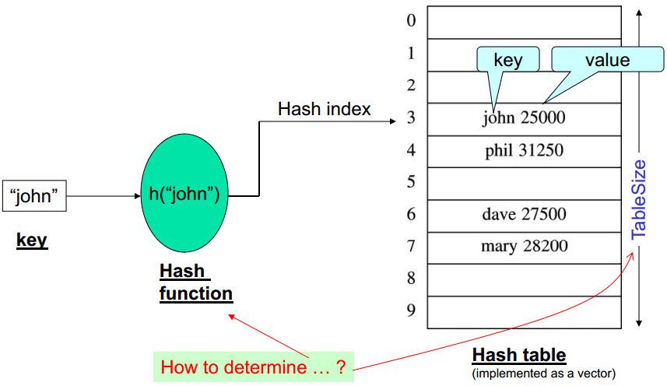
Also…

Slide 5
HashFunction(SomeKey)=Integer Value
To support insertion, deletion and search in average-case const time
*Not* useful for if you want to maintain or retrieve elements in order.

Slide 6
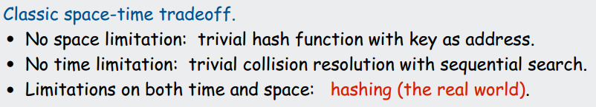
Ideal condition:
Reduce chances of collisions
Scramble the keys uniformly.
Each position equally likely for each key.
Should be efficiently to compute.

Slide 7
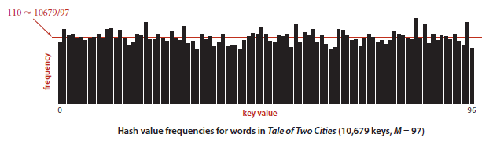
Uniformity

Slide 8
For example,
What would be the better hash for:
Date of Birth
Birth Year? Birth Month? Birth Day?
Phone Numbers
First three digits? Last three digits?
Best case would be to use the whole thing to compute the hash.

Slide 9
Hash Function
For example, for strings:
“data”, Use the ASCII characters and sum
100+97+116+97 = 410
Should we place it on index 410?
Where would we place: Pneumonoultramicroscopicsilicovolcanoconiosis?
We use the modulus operator. If our table size of 50, we place “data” at index 10. (410%50 = 10)
It is better to use arrays of whose size of equal to a Prime number.

Slide 10
Or we can use come keys. For example use first m letters from the string.
If m=3, “dat” for data
“Pak” for Pakistan
etc

Slide 11

For example
int hash31 (char key[Key_Length])
{
int h = 0;
int i;
for (i=0; i < Key_Length ; i++)
{
h = (31 * h + key[i]) % tbl_size;
}
return h;
}

Slide 12

Table index should always be positive, so
0x7FFFFFFF is 0111 1111 1111 1111 1111 1111 1111 1111 : all 1 except the sign bit.
Why not use absolute function?

Slide 13
Hash Function -> Used to map a key to an array index
Hash Table -> An array of some fixed size
Collision -> If two or more values end up with the same hash value. E.g. In slide 2-> 907, Mango, 507, Apple both get the value 7.

Slide 14
Collision Resolutions
Separate Chaining
A straightforward and general approach to collision resolution is to build, for each of the M array indices, a linked list of the key-value pairs whose keys hash to that index. This method is known as separate chaining because items that collide are chained together in separate linked lists.
"maintains a linked list at every hash index for collided elements"

Slide 15
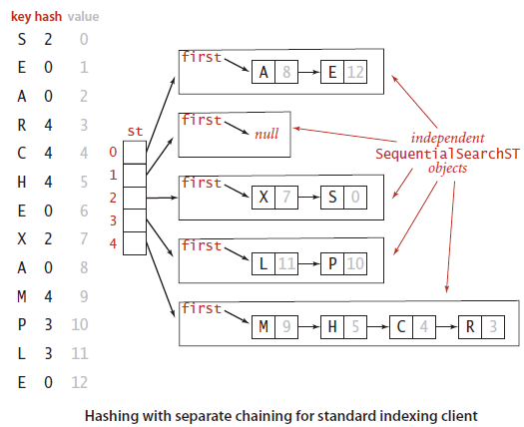

Slide 16
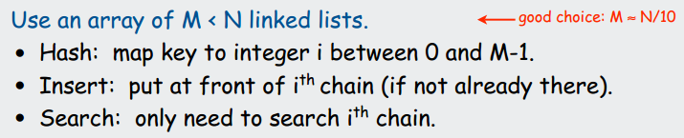

Slide 17
Average length = N / M.
Worst case: all keys hash to same list.

Slide 18
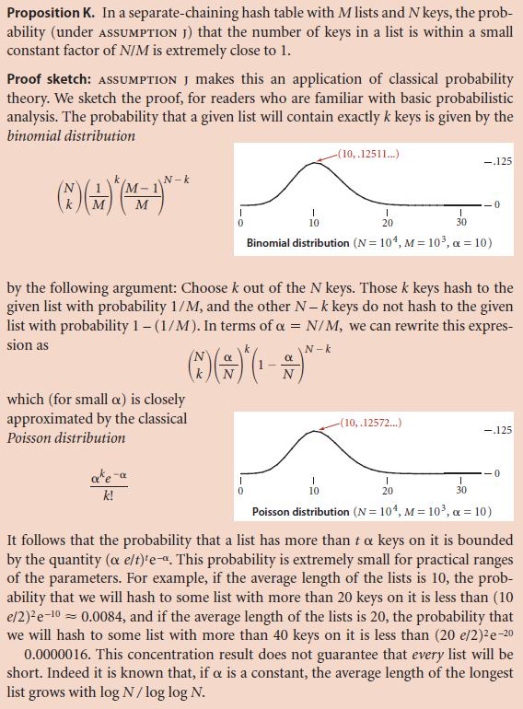

Slide 19
Table Size
In a separate-chaining implementation, our goal is to choose the table size M to be sufficiently small that we do not waste a huge area of contiguous memory with empty chains but sufficiently large that we do not waste time searching through long chains.
If more keys arrive than expected, then searches will take a little longer.
If fewer keys are in the table, then we have extra-fast search with some wasted space.

Slide 20
Collision resolution with Open Addressing
Another approach to implementing hashing is to store N key-value pairs in a hash table of size M > N, relying on empty entries in the table to help with collision resolution. Such methods are called open-addressing hashing methods.

Slide 21
Open addressing with Linear Probing
When we hash to a table index that is already occupied with a key different from the search key, we just check the next entry in the table by incrementing the index.

Slide 22
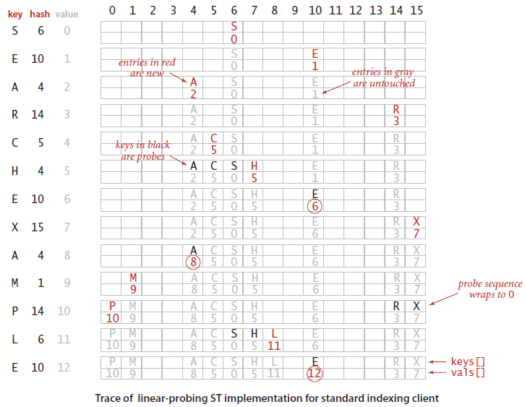

Slide 23
Basically:
Key equal to search key: search hit
Empty position (null key at indexed position): search miss
Key not equal to search key: try next entry
Simple enough, but what if we need to delete any entry.

Slide 24
If we just mark the space as null, our search result would terminate as soon as it finds the null value.
So, if we delete any key, we will have to “reinsert” all keys to it right until the next null.

Slide 25
What if list gets full, i.e. no empty space?

Slide 26
Clusters
Contiguous groups of occupied table entries, called clusters
A,C,H,S is a cluster.
The longer the cluster, the longer time it will take to search or insert.
The more elements there are, the more clustering will occur and also, the clusters will become longer and longer.

Slide 27
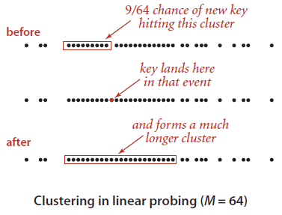

Slide 28
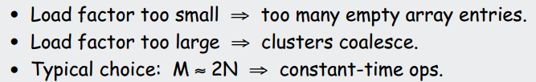
Average length of cluster = N / M.
(N/M is also called Load factor.)
Worst case: all keys hash to same cluster

Slide 29
Resizing necessary.
Double the size of the table and insert all elements again.
For linear probing, implementing array resizing is necessary.

Slide 30
Variations possible
Many improved versions have been studied:
E.g.: Two-probe hashing (separate chaining)
Hash to two positions, put key in shorter of the two lists.
Reduces average length of the longest list to log log N
E.g.: Double hashing
Use linear probing, but skip a variable amount, not just 1 each time.
Effectively eliminates clustering
Can allow table to become nearly full
Formula: (HashFunc1 + no. of collisions x HashFunc2)%M

Slide 31
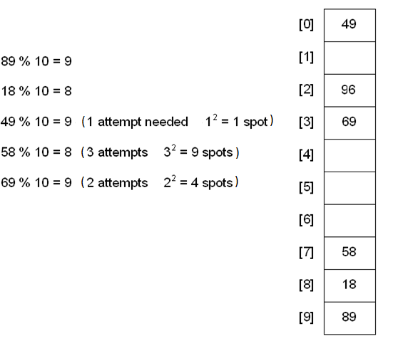
Hashing with Quadratic Probe

Slide 32
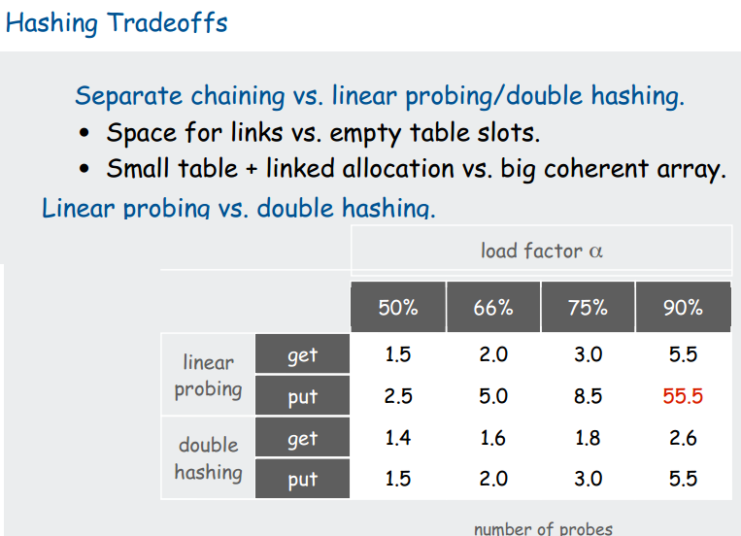

Slide 33
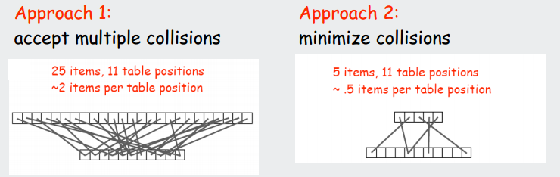

Slide 34
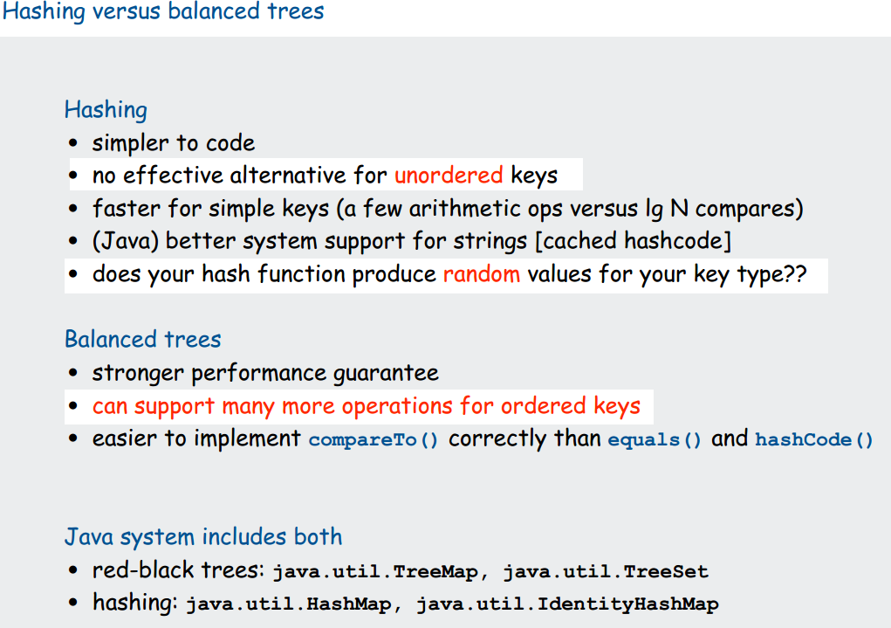

Slide 35
References
http://www.eecs.wsu.edu/~ananth/CptS223/Lectures/hashing.pdf
https://ece.uwaterloo.ca/~cmoreno/ece250/2012-02-01--hash_tables.pdf

